Slide 1
Lesson 3
Random vs Natural Networks

Slide 2
Natural vs. Random
Erdos-Renyi random graphs
Developed in the late 1950’s to describe pure random generation of graphs.
Watts-Strogatz small world model
A random graph that has short average path lengths and high clustering
Barabasi-Albert scale-free networks
A random graph model used to explain the existence of “hubs” in real networks.

Slide 3
Theorem of Network Structures (1)
Social networks in the real world, in general, tend to have shorter average path lengths and diameters indicating that we are able to reach vast majority of the nodes in these networks with fewer connections
An Erdos-Renyi random graph G with n nodes is a graph in which each link formed independently with some probability p
Such a random graph, also referred to as Erdos-Renyi G(n, p) graph, serves as a benchmark for comparing real-world networks to see if these networks are simply a random phenomenon or do they arise systematically

Slide 4
Erdos Renyi
Suppose there is a vertex set and a parameter λ where λ = np (n is the number of nodes and p is the independent probability of a tie between any two nodes.)
A critical point exists at λ = 1.
λ < 1 → all components are small with the largest of order log(n)
λ > 1 → the graph will have a giant component and the second largest component will be order log(n)
λ = 1 the largest components have size n^(2/3)

Slide 5
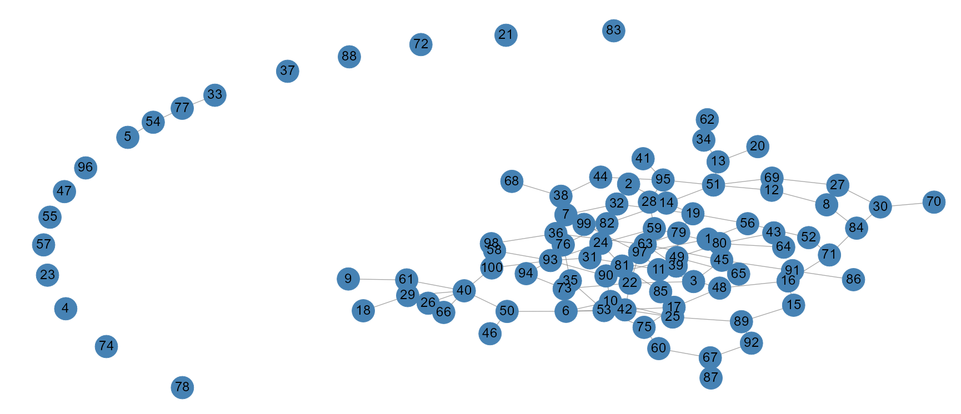
Erdos Renyi (n = 100, p = 0.02)

Slide 6
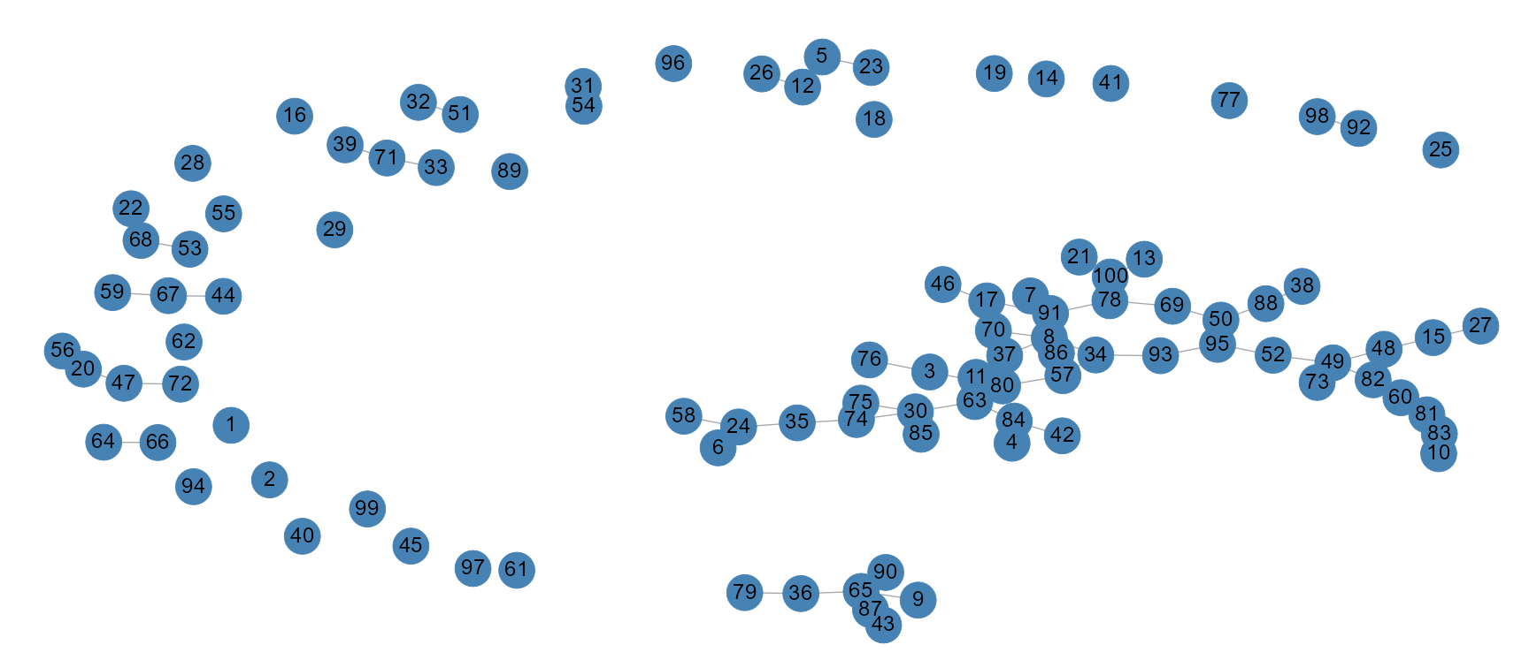
Erdos Renyi (n = 100, p = 0.01)

Slide 7
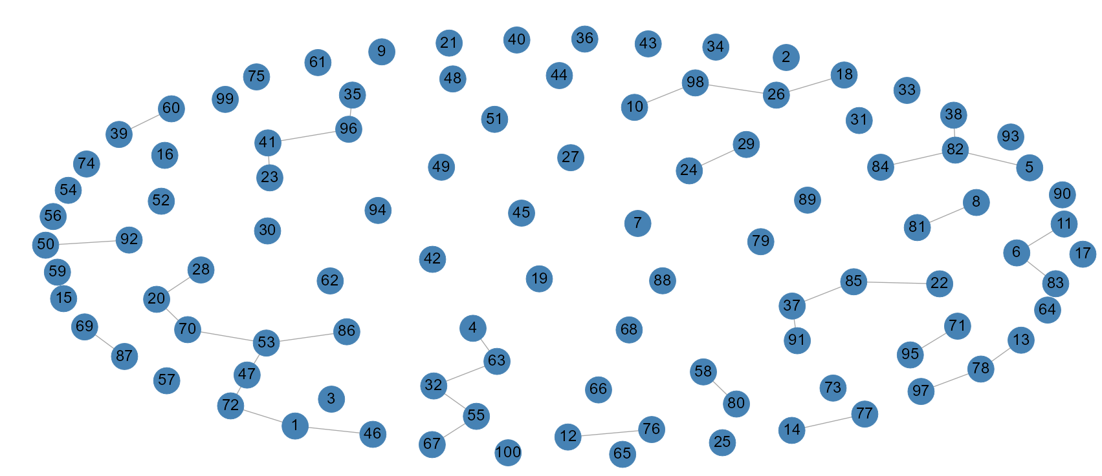
Erdos Renyi (n = 100, p = 0.05)

Slide 8
Theorem of Network Structures (2)
Laws of large numbers allow us to make generalized probabilistic statements such as
the average degree of a network with n nodes is at least as large as the log of the number of nodes
d(n) ≥ (1 + ɛ) log(n) for some ɛ > 0
In large networks, links are dense enough so that network is connected and there is a high degree of probability that we can reach any node in the network from any other node
the average degree of a node is very small compared to the number of nodes in the network so the network is not too complete
d(n) / n → 0
It is not the case that every node can reach another node with a path length of 1

Slide 9
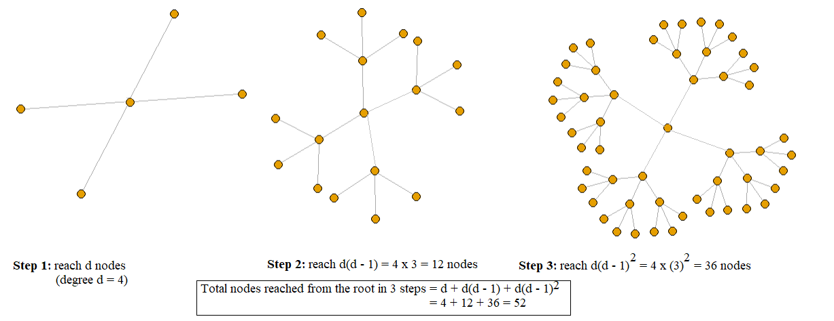
Theorem of Network Structures (3)
Given these two conditions, we can say with a high degree of probability that when n is large, the average path length and diameter of the network are approximately proportional to the ratio of the log of number of nodes to the log of the average degree of the network
log(n) / log(d)

Slide 10
Theorem of Network Structures (4)
In step m, we can reach d(d – 1)^{m - 1} nodes. So the number of nodes reached out from the root in m steps is:
d + d(d – 1) + … + d(d – 1)^{m - 1} = d((d – 1)^{m} – 1) / (d – 2)
≈ (d – 1)^{m}
The first step above is simply the sum of a geometric series. The second step is an approximation
To reach (n – 1) nodes from the root in m steps, therefore:
(d – 1)^{m} = n
Taking log of both sides and approximating (log(d) ≈ log(d – 1)) we get:
m = log(n) / log(d)

Slide 11
Theorem of Network Structures (5)
Social networks in the real world, therefore, tend to have shorter average path lengths and diameters indicating that we are able to reach vast majority of the nodes in these networks with fewer connections
The world population is n = 7.6 billion and if we assume that typical number of friends and relatives a person has is d = 50 then log(n) / log(d) ≈ 6.
The number 6 is known as the six degrees of separation, i.e., to get from one individual to the other in the world you only need six hops, a small world!

Slide 12
ER graphs miss...
The ER model assumes consistent, independent probabilities of ties. But, in the real world::
When node A is connected to B and B is connected to C it increases the chance that A is connected to C (triadic closure). This produces low clustering within the graphs (clustering coefficients will be covered in a later topic)
The degree distribution of ER graphs converge to a Poisson Distribution (count of events distribution) which does not mimic real world factors (we’ll come back to this later today).

Slide 13
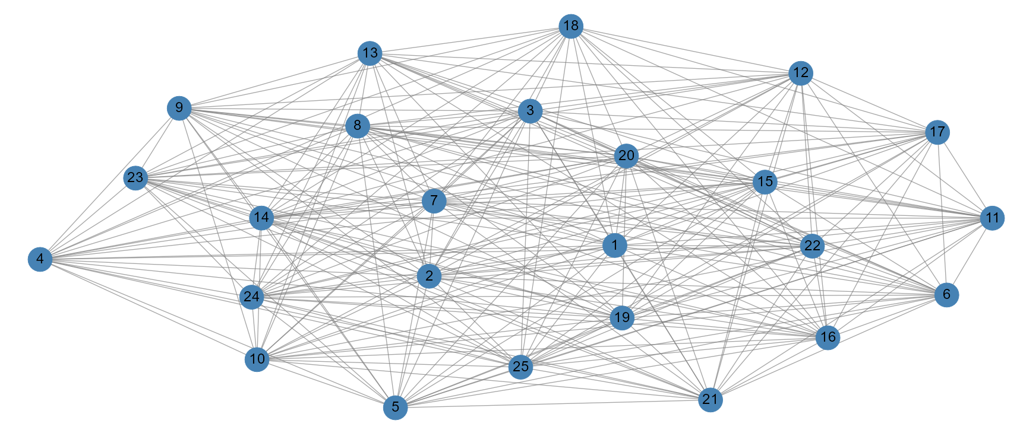
The Watts-Strogatz Model
Add random “rewirings” to the model in order to reduce the average path length.

Slide 14
Theorem of Network Structure (6)
The Watts-Strogatz model reduces the average path length to sufficiently model real world situations in some cases, but lacks realism in the representation of hubs.
When analyzing the structure of a network we need to consider its degree distribution
It turns out that if we were to analyze the number of links (or degrees) and the corresponding frequency of nodes having those links (or degrees) then random networks follow a scale free distribution. That is a large number of nodes have a low degree and a small number has a higher degree such that the graphs do not exhibit a fat or heavy tail.
In real life, however, many networks are heavy tailed, i.e., there are more low and high degree nodes than those predicted at random. For instance, citation networks tend to show many papers with 0 citations and too many with high number of citations.

Slide 15
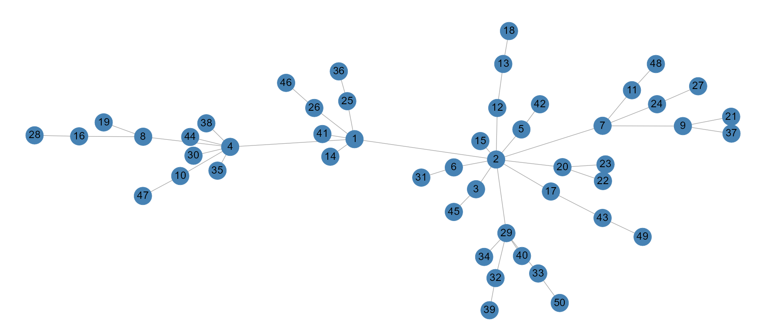
The Barbasi-Albert Model
Growth and preferential attachment are natural
Growth simply means new nodes are added.
The more connected a node is, the more likely it is to receive new ties. (Visibility, popularity, trust, etc…) i.e. “the rich get richer”

